Slide 1
Что Вы знаете о кино?
What do you know about cinema?
Prezentacii.com

Slide 2
Objectives:
To practise reading for specific information;
To practise reading for detail;
To practise listening for specific information

Slide 3
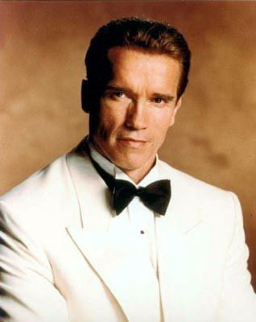
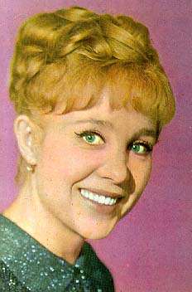
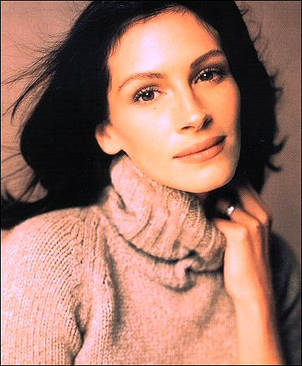
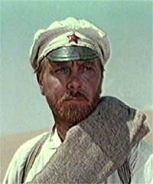
The century of film making

Slide 4
Look at the list of words and say which words are similar in Russian? And then make up as many word combinations with these words as you can
Actor
Actress
Character
Costumes
Dialogues
Situation
Music
Part
Photography
Plot
Scene
Special effects

Slide 5
How often do you go to the cinema?
What genres of films do you know?
What films do you prefer and why?
What famous actors and actresses do you know?
Who is your favourite actor?
What is your favourite film?

Slide 6
The twentieth century may be called the century of film making. Cinema plays an important role in the life of any society. It is an available popular form of art. Lots of people find going to the cinema one of the best ways of spending their leisure time. But not everyone knows when and how cinematography appeared.
Ембекова А.В. МОУ СОШ № 3 г. Вольск Саратовской области

Slide 7
Do you know who made the first film? What was it about?

Slide 8
“Arrival of the train”

Slide 9
Listen to the information to check if you are right
The inventors of the cinema were the Americans.
The first film projector was invented in 1885.
The first three minutes film was demonstrated in the same year.
In that film, a plane came towards the camera.

Slide 10
Your homework
The development of cinematography brought to life the world cinema empire called Hollywood. What do you know about Hollywood? What would you like to know about it? Write a list of questions which you would like to ask about Hollywood.

